Slide 1




Chapter 17: Analysis and Interpretation: Individual Variables Independently

Slide 2
Learning Objectives
Distinguish between univariate and multivariate analyses
Describe frequency analysis
Describe descriptive statistics
Discuss confidence intervals for proportions and means
Overview the basic purpose of hypothesis testing

Slide 3
Data Analysis: Two Key Considerations
(1) Is the variable to be analyzed by itself (univariate analysis) or in relationship to other variables (multivariate analysis)?
(2) What level of measurement was used?
If you can answer these two questions, data analysis is easy…

Slide 4

Measures
Categorical Measures
A commonly used expression for nominal and ordinal measures
Continuous measures
A commonly used expression for interval and ratio measures

Slide 5
The Avery Fitness Center (AFC) Project
Research Problems:
(1) discover existing member demographics and usage patterns (including fees paid)
(2) investigate how members initially learn about AFC
Population: AFC members who had visited AFC at least once in the prior 12 months
Simple random sample
Mail survey; 231 suable responses (58% response rate)
Primary data matched to secondary data (i.e., fees paid over prior 12 months)

Slide 6

Basic Univariate Statistics: Categorical Measures
Frequency Analysis
A count of the number of cases that fall into each of the possible response categories
An incredibility common and useful type of analysis

Slide 7
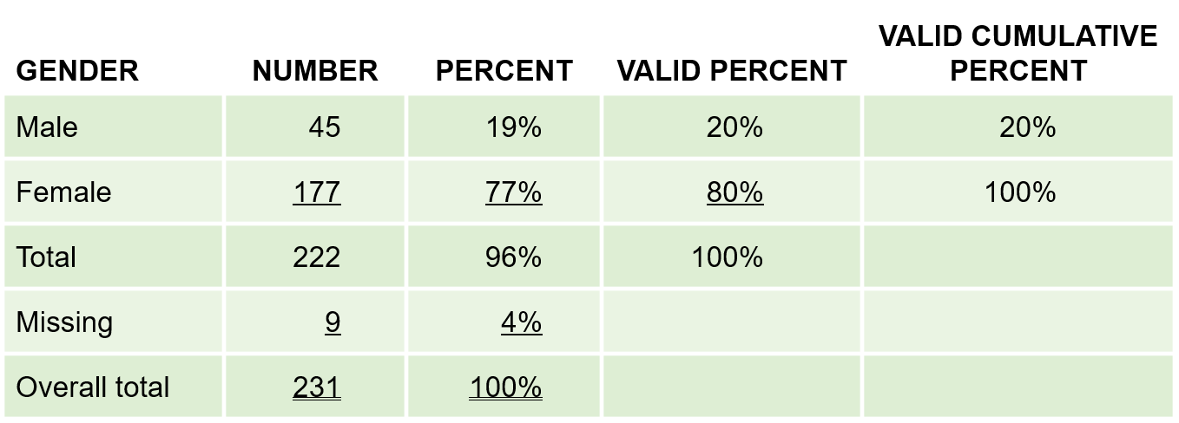
The Avery Fitness Center (AFC)
Exhibit 17.1 Avery Fitness Center: Gender

Slide 8
Use of Percentages
Percentages are very useful for interpreting the results of categorical analyses and should be included whenever possible
Unless your sample is VERY large; however, report percentages as whole numbers (i.e., no decimals)

Slide 9
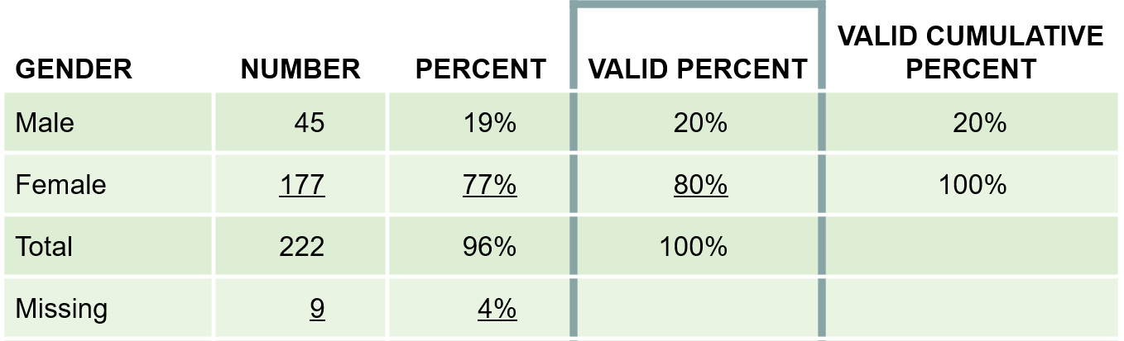
Frequency Analysis
Researchers almost always work with “valid” percentages which are simply percentages after taking out cases with missing data on the variable being analyzed
Exhibit 17.1 Avery Fitness Center: Gender

Slide 10
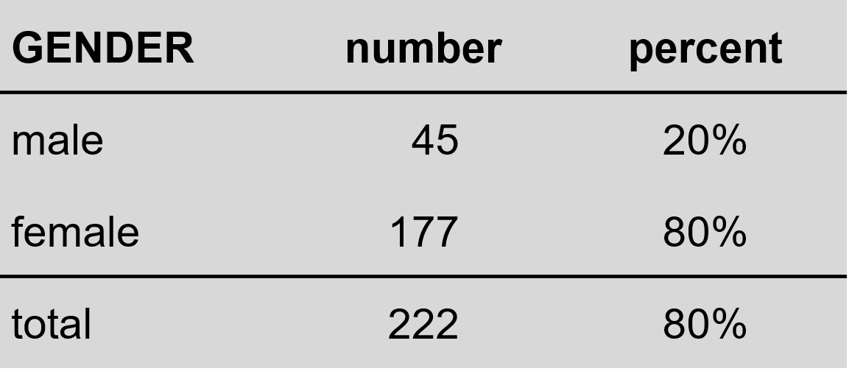
Presenting Frequency Analysis Results
(missing = 9)

Slide 11
Uses of Frequency Analysis
Univariate categorical analysis
Identify blunders and cases
Identify outliers
Outlier: an observation so different in magnitude from the rest of the observation that the analyst chooses to treat it as a special case
Identify the median

Slide 12
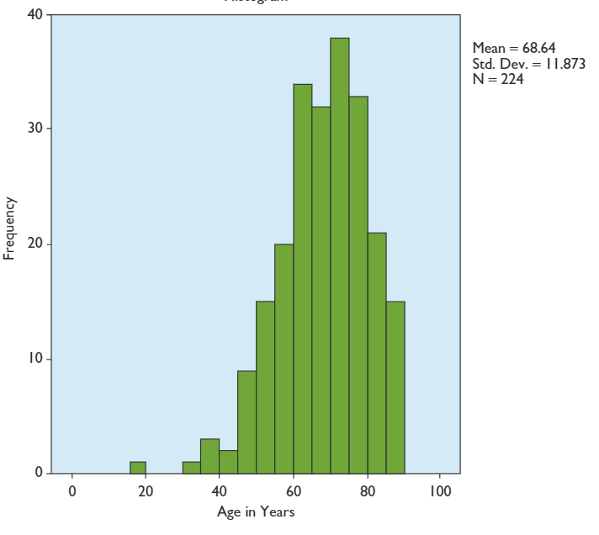
Uses of Frequency Analysis

Slide 13

Uses of Frequency Analysis
Histogram
A form of bar chart on which the values of the variable are placed along the x-axis and the absolute or relative frequency of the values is shown on the y-axis

Slide 14
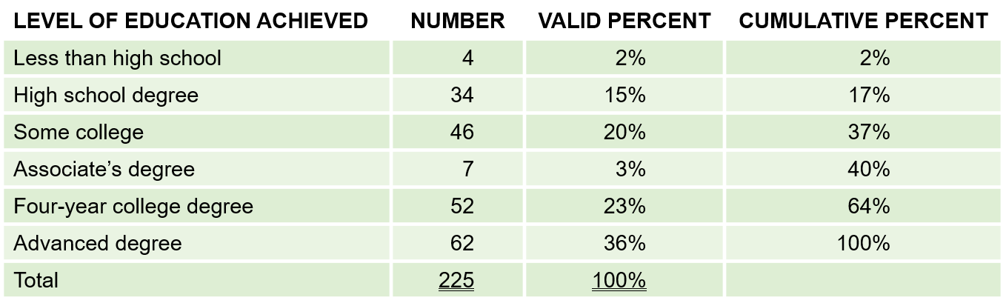
Uses of Frequency Analysis
Exhibit 17.2 Avery Fitness Center: Level of Education
The MEDIAN level of education is found by identifying the level that contains the 50th percentile in the frequency distribution.

Slide 15

Confidence Intervals for Proportions (Categorical Measures)
Confidence Interval
A projection of the range within which a population parameter will lie at a given level of confidence, based on a statistic obtained from a probabilistic sample
This is why you need to draw a probability sample

Slide 16
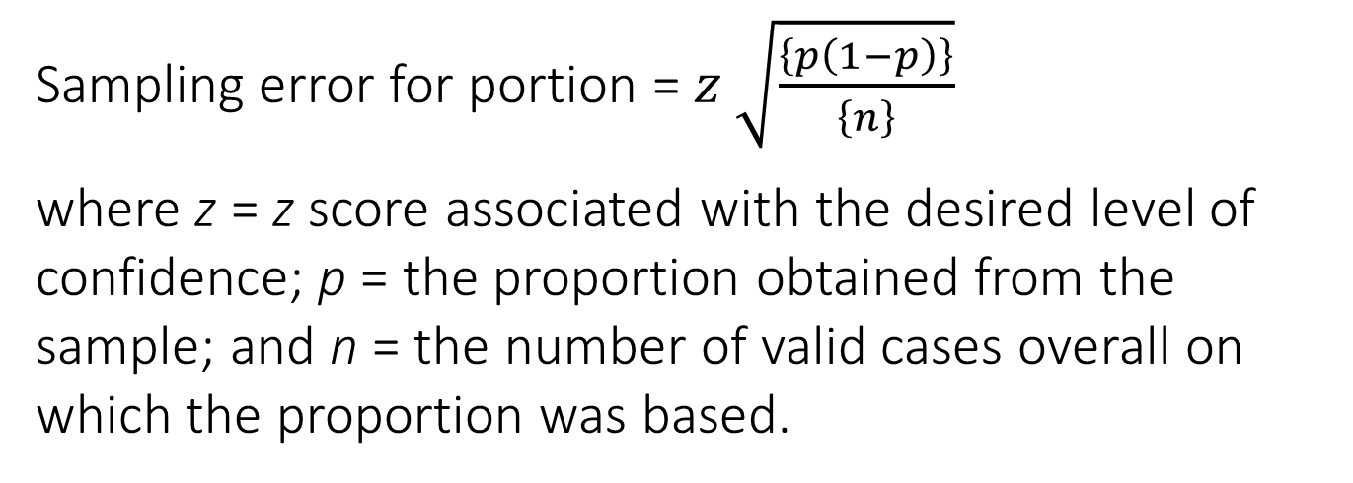
Confidence Intervals for Proportions (Categorical Measures)
Sampling error for portion = $z \sqrt{\frac{\left\{p\left(1−p\right)\right\}}{\left\{n\right\}}}$
where z = z score associated with the desired level of confidence; p = the proportion obtained from the sample; and n = the number of valid cases overall on which the proportion was based.
CONFIDENCE INTERVAL:

Slide 17
Question: What percentage of AFC members are women?
Solution: Compute the 95% confidence interval based on the proportion of respondents in the sample that indicated that they were women.

Slide 18
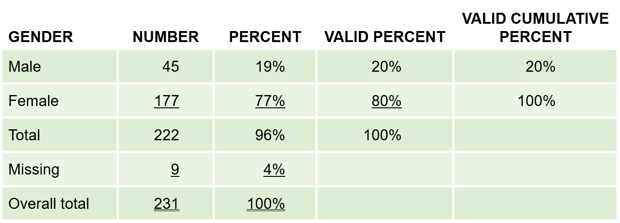
Question: What percentage of AFC members are women?
Based on the sample result, our best guess is that 80% of the population are women…
Exhibit 17.1 Avery Fitness Center: Gender

Slide 19
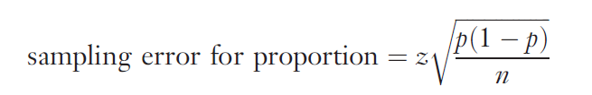
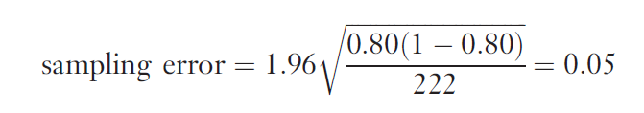
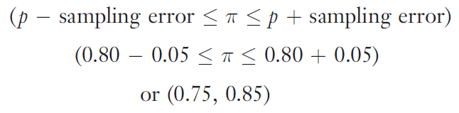
Question: What percentage of AFC members are women?
Therefore, we would be 95% confident that the proportion of women in the AFC population lies between .75 and .85, inclusive.

Slide 20

Caution in Interpreting Confidence Intervals
The confidence interval only takes sampling error into account
It DOES NOT account for other common types of error (e.g., response error, nonresponse error)
The goal is to reduce TOTAL error, not just on type of error.

Slide 21
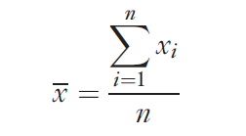
Basic Univariate Statistics
Descriptive Statistics
Statistics that describe the distribution of response on a variable. The most commonly used descriptive statistics are the mean and standard deviation.
Sample Mean: the arithmetic average value of the responses on a variable

Slide 22
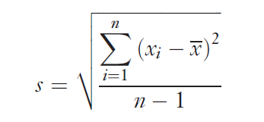
Basic Univariate Statistics
Sample Standard Deviation
A measure of the variation of responses on a variable. The standard deviation is the square root of the calculated variance on a variable.

Slide 23
Why worry about the Sample Standard Deviation?
Case– the New Sauce Product
The mean score on a measure of how hot consumers preferred a new sauce to be suggested that they wanted it moderately hot. Unfortunately, most consumers either wanted it wild or hot, with relatively little demand for a moderate sauce

Slide 24

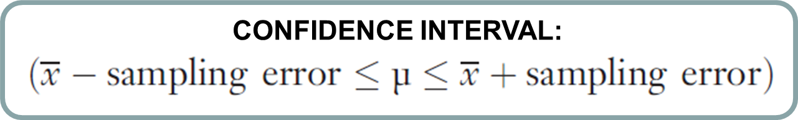
Confidence Intervals for Means (Continuous Measures)
where
z = z score associated with the desired level of confidence
s = the sample standard deviation
n = the total number of cases used to calculate the mean.

Slide 25
Question: How many times per month do AFC members visit the center?
Solution: Compute the 95% confidence interval based on the mean number of visits to the Center reported by sample respondents.
Based on the responses of 198 AFC members, we learn that the mean number of trips was 10.0, with a standard deviation of 7.3

Slide 26
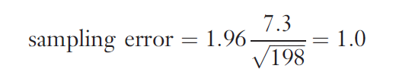
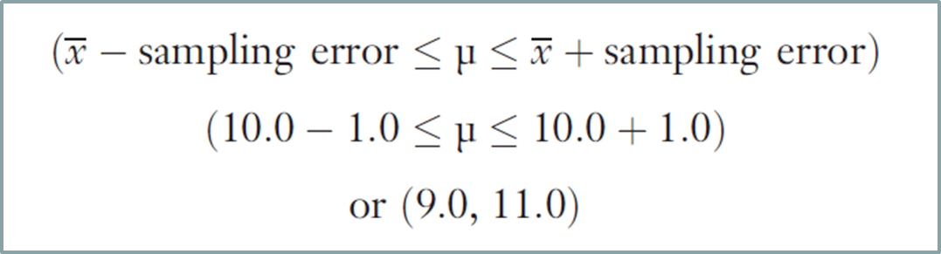
Question: How many times per month do AFC members visit the center?
Therefore, we would be 95% confident that the mean number of trips per month in the AFC population lies between 9 and 11, inclusive.

Slide 27
Converting Continuous Measures to Categorial Measures
Sometimes it is useful to convert continuous measure to categorical measures
This is legitimate because measures at higher levels of measurement (in this case, continuous measures) have all the properties of measures at lower levels of measurement (categorical measures)
Why do this? Ease of interpretation

Slide 28

Common Approaches
Common Approaches:
Judgment
Median split
Cumulative % breakdowns
Two-box technique

Slide 29
Median Split
A technique for converting a continuous measure into a categorical measure with two approximately equal sized groups. The groups are formed by “splitting” the continuous measure at its median value

Slide 30

Common Approaches
The MEDIAN level of education is found by identifying the level that contains the 50th percentile in the frequency distribution
Exhibit 17.2 Avery Fitness Center: Level of Education

Slide 31
Common Approaches
Using a median split will result in two education groups, a lower education group (64%; less than high school, high school degree, some college, associate’s degree, four-year college degree) and a higher education group (36%; advanced degree).
An alternative approach that would produce a more even split of AFC respondents would be to combine those with a four-year or advanced degree as the higher education group.

Slide 32
CUMULATIVE PERCENTAGE BREAKDOWN
A technique for converting a continuous measure into a categorical measure. The categories are formed based on the cumulative percentages obtained in a frequency analysis.

Slide 33
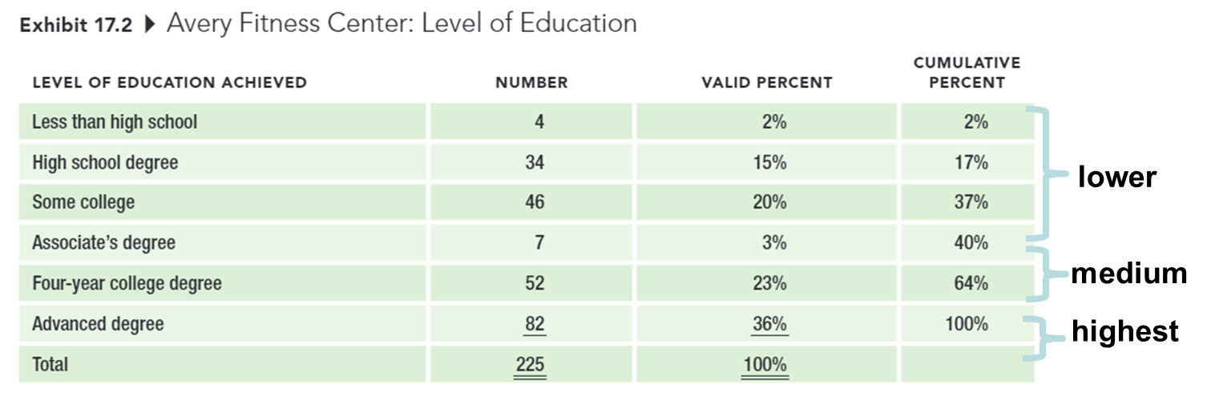
CUMULATIVE PERCENTAGE BREAKDOWN
Notes:
If we wanted three approximately equal-sized education groups instead of six, we could use the cumulative percentage breakdown to construct the groups.

Slide 34
TWO-BOX TECHNIQUE
A technique for converting an interval-level rating scale into a categorical measure, usually used for presentation purposes. The percentage of respondents choosing one of the top two positions on a rating scale is reported.

Slide 35
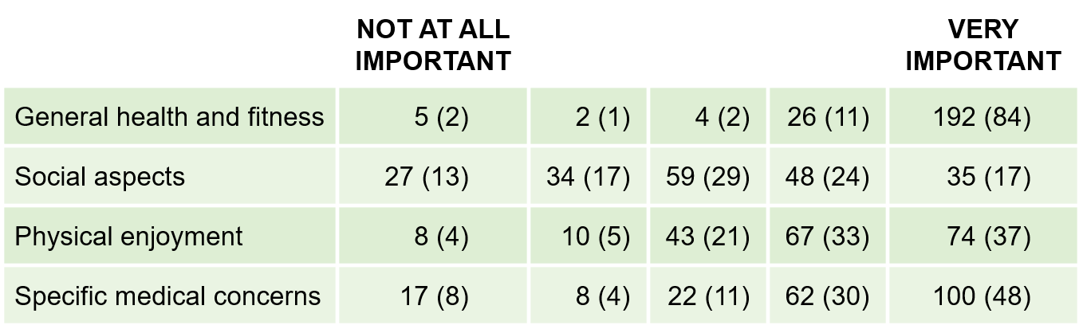
TWO-BOX TECHNIQUE
Exhibit 17.6 Avery Fitness Center: Reasons for Participation “How important to you personally is each of the following reasons for participating in AFC programs?”
Number (Percentage) of Respondents Selecting Each Response Category

Slide 36
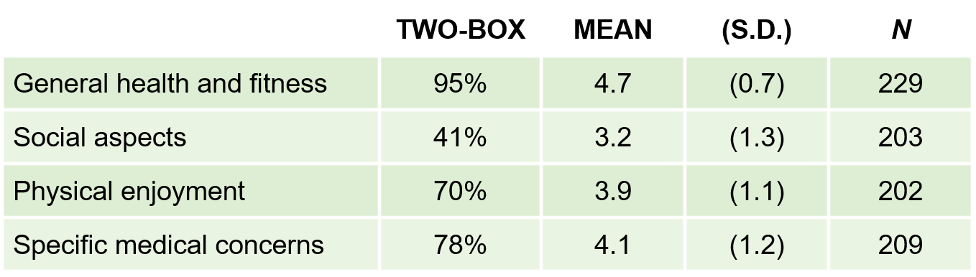
TWO-BOX TECHNIQUE
Exhibit 17.7 Avery Fitness Center: Two-Box Results, With Descriptive Statistics

Slide 37
Hypothesis Testing
THE ISSUE: How can we tell if a particular result in the sample represents the true situation in the population… or simply occurred by chance?
HYPOTHESIS: Unproven propositions about some phenomenon of interest.
NULL HYPOTHESIS: The hypothesis that a proposed result is not true for the population.
ALTERNATIVE HYPOTHESIS: The hypothesis that a proposed result is true for the population.

Slide 38
Hypothesis Testing
SIGNIFICANCE LEVEL (α)
The acceptable level of error selected by the researcher, usually set at 0.05. The level of error refers to the probability of rejecting the null hypothesis when it is actually true for the population.
p-VALUE
The probability of obtaining a given result if in fact the null hypothesis were true in the population. A result is regarded as statistically significant if the p-value is less than the chosen significance level of the test.

Slide 39

Common Misinterpretations of what “Statistically Significant” Means
Viewing p-values as if they represent the probability that the results occurred because of sampling error (e.g., p = .05 implies that there is only a .05 probability that the results were caused by chance)
Assuming that statistical significance is the same thing as managerial significance
Viewing the $α$ or p levels as if they are somehow related to the probability that the research hypothesis is true (e.g., a p-value such as p>.001 is “highly significant” and therefore more valid than p< .05).

Slide 40
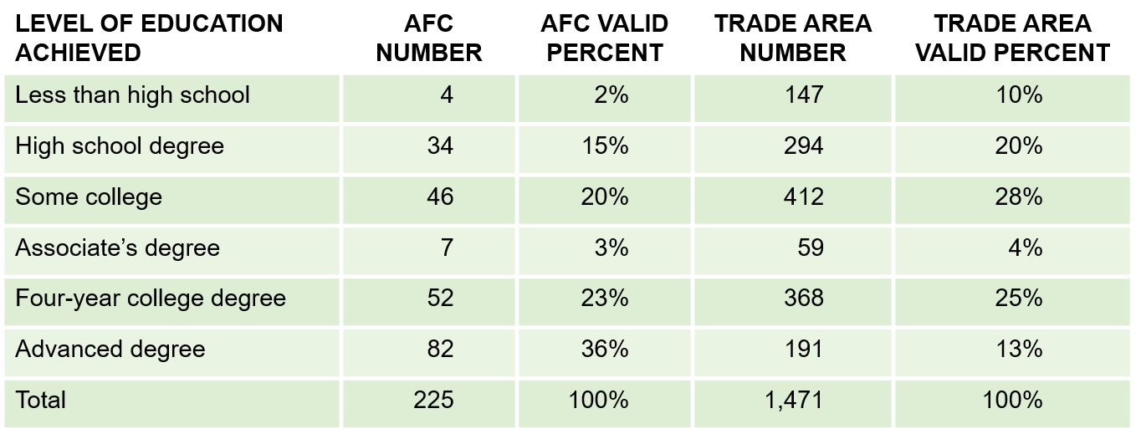
Testing Hypotheses about Individual Variables
Categorical Variables: Chi-square goodness-of-fit test: A statistical test to determine whether some observed pattern of frequencies corresponds to an expected pattern.
Exhibit 17.8 AFC Customer Education Level Versus Education Level in Trade Area
(Χ² = 118.38, 5 d.f., p < .001)

Slide 41
Testing Hypotheses about Individual Variables
Continuous Variables: A one-sample t-test can be used to compare a sample mean against an external standard. The analysis is easy to implement in a standard statistical software analysis package.

Slide 42
Assignment 7: Mid-semester Peer Evaluation

Slide 43
5-min snippet

